Slide 1

Employee Data Analysis using Excel
STUDENT NAME:K.Monisha
REGISTER NO:122203599
DEPARTMENT:B. Com (corporate secretaryship)
COLLEGE:Soka ikeda college of arts and science for women
1
Notes:
1

Slide 2

PROJECT TITLE
Employee Performance Analysis using Excel
Subtitle: Leveraging Excel Filtering, Highlighting, and Pivot Charts for Insights
M.Saranya
Date – 30/08/2024
2
Notes:
2

Slide 3



AGENDA
Problem Statement
Project Overview
End Users
Our Solution and Proposition
Dataset Description
Modelling Approach
Results and Discussion
Conclusion
3/21/2024 Annual Review
3
Notes:
3

Slide 4

PROBLEM STATEMENT
Key Issues:
Difficulty in tracking and analyzing employee performance effectively.
Time-consuming processes to filter and interpret performance data.
Lack of visualization leading to poor decision-making.
Objective: To develop a systematic approach for analyzing employee performance using Excel’s advanced features.
4
Notes:
4

Slide 5

PROJECT OVERVIEW
.
Scope:
Analysis of employee performance metrics across various departments.
Use of Excel for data manipulation, highlighting key metrics, and creating visual representations.
Tools:
Excel filters, conditional formatting, pivot tables, and charts.
Expected Outcome:
A comprehensive and easily interpretable performance analysis.
5
Notes:
5

Slide 6

WHO ARE THE END USERS?
HR Department: For evaluating employee performance and identifying areas of improvement.
Management: For making informed decisions based on performance data.
Team Leaders: For tracking team performance and setting future goals
6
Notes:
6

Slide 7

OUR SOLUTION AND ITS VALUE PROPOSITION
Conditional Formatting Issues
Removal of Unnecessary Filters
Optimizing Formula Performance
Pivot Table Summarization
Data Visualization with Graphs
7
Notes:
7

Slide 8
Dataset Description
Source: Employee performance records (e.g., attendance, task completion, ratings, etc.)
Key Metrics:
Productivity scores
Attendance rates
Task completion times
Customer feedback ratings
Data Size: Number of employees, time frame of analysis, etc.
Notes:
8

Slide 9
MODELLING
Data Filtering:
Use of Excel filters to isolate specific metrics (e.g., top performers, low attendance).
Highlighting:
Conditional formatting to highlight KPIs such as highest productivity, lowest task completion time.
Pivot Charts:
Creation of pivot tables to aggregate data and generate charts for visual trends.
Analysis Steps:
Step-by-step process from raw data to final visualizations.
9
Notes:
9

Slide 10
Results and Discussion
Data Filtering:
Use of Excel filters to isolate specific metrics (e.g., top performers, low attendance).
Highlighting:
Conditional formatting to highlight KPIs such as highest productivity, lowest task completion time.
Pivot Charts:
Creation of pivot tables to aggregate data and generate charts for visual trends.
Analysis Steps:
Step-by-step process from raw data to final visualizations.
Notes:
10

Slide 11
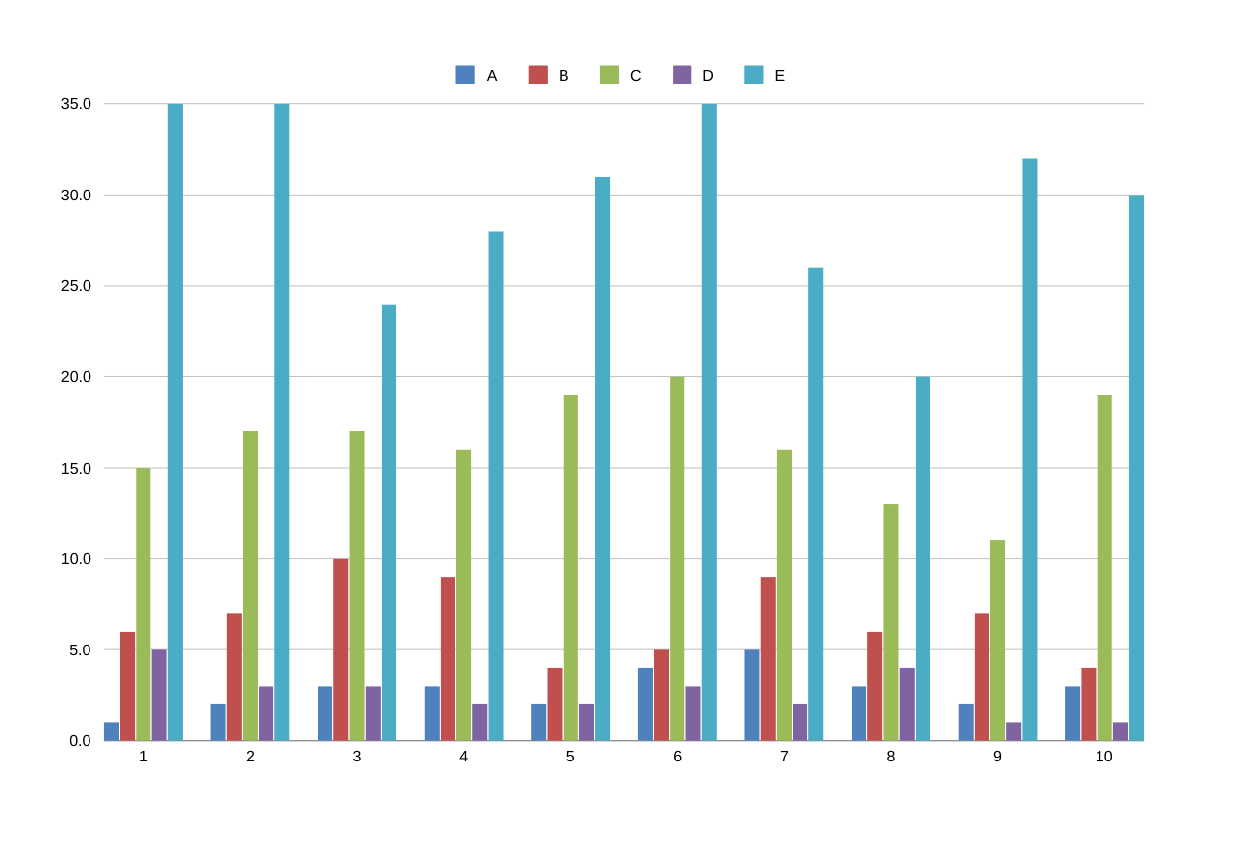
RESULTS
11
Notes:
11

Slide 12
RESULTS
Notes:
12

Slide 13
conclusion
Summary:
Recap of the methodology used for performance analysis.
Emphasize the effectiveness of Excel tools in gaining actionable insights.
Next Steps:
Recommendations for further analysis or implementation in regular performance reviews.
Closing Statement:
The value of data-driven decision-making in enhancing employee performance.
Notes:
13

